Slide 1

Major Project – II ()
Review - 1
Presented By – DEEPAK BOMMANA, AASAM BHANUPRAKASH REDDY, MAVILLAPALLI M V SRI VIGNESWAR, SAI KRISHNA PUDI
Project Name /Company Name :GA-based Hyperparameter Optimizer for KNN and SVM
Mentor/ Guide Name:PROF. JAGARLAMUDI SAAI PAVAN

Slide 2

Contents
Project / Problem Identification
Abstract
Introduction
Functionality
implementation
Project Analysis
Literature Review
Result
conclusion

Slide 3
Project / Problem Identification
Problem Statement:
Use a Genetic Algorithm to automatically discover the best hyperparameters (K for KNN, C and gamma for SVM) by encoding them as chromosomes and evolving a population using classification accuracy as the fitness function over 50 generations.
Issues:
Manual tuning is inefficient
Grid search is computationally expensive
Random search lacks direction
Solution:
Use Genetic Algorithm (GA) to automatically find optimal hyperparameters

Slide 4
Abstract
Hyperparameter tuning is a critical step in improving the performance of machine learning models. Traditional methods such as Grid Search and Random Search are often time-consuming and may not efficiently explore the search space. This project proposes the use of a Genetic Algorithm (GA) to automatically optimize the hyperparameters of K-Nearest Neighbors (KNN) and Support Vector Machine (SVM) models.
In this approach, hyperparameters such as K (for KNN) and C and gamma (for SVM) are encoded as chromosomes. A population of solutions is evolved over 50 generations using genetic operations like selection, crossover, and mutation. The fitness of each solution is evaluated using classification accuracy.
The results demonstrate that the Genetic Algorithm effectively identifies optimal parameter values and improves model performance. This approach reduces manual effort, enhances accuracy, and provides an efficient solution for hyperparameter optimization in machine learning.

Slide 5
Introduction
Machine Learning (ML) has become an essential tool in solving complex real-world problems such as classification, prediction, and pattern recognition. The performance of machine learning models largely depends on the selection of appropriate hyperparameters. Hyperparameters are configuration settings that control the learning process, such as the number of neighbors in K-Nearest Neighbors (KNN) and parameters like C and gamma in Support Vector Machines (SVM).
Traditionally, hyperparameter tuning is performed manually or using methods like Grid Search and Random Search. However, these approaches are time-consuming and may not always produce optimal results, especially when the search space is large. Therefore, there is a need for an efficient and automated method for hyperparameter optimization.
Genetic Algorithms (GA), inspired by the process of natural selection, provide a powerful optimization technique. They work by evolving a population of candidate solutions through operations such as selection, crossover, and mutation. GA is capable of exploring a wide search space and finding near-optimal solutions efficiently.
In this project, a Genetic Algorithm is used to optimize the hyperparameters of KNN and SVM models. The algorithm encodes model parameters as chromosomes and evaluates them using classification accuracy as a fitness function over multiple generations. The objective is to automatically identify the best model and parameter combination that yields the highest accuracy.
This approach reduces manual effort, improves model performance, and demonstrates the effectiveness of evolutionary algorithms in machine learning optimization tasks.

Slide 6
Functionality
1. Data Input
The system accepts a dataset as input in CSV format. The dataset contains features and a target variable used for classification.
2. Data Preprocessing
The input data is cleaned and prepared by:
Separating features and target
Encoding categorical values (if any)
Normalizing features using scaling techniques This step ensures better model performance.
3. Population Initialization
The system generates an initial population of random solutions (chromosomes). Each chromosome represents a model (KNN or SVM) along with its hyperparameters.
4. Model Training and Evaluation
Each chromosome is evaluated by training the corresponding model and calculating its accuracy. This accuracy is used as the fitness value.
5. Selection Mechanism
The system selects the best-performing individuals based on fitness. These individuals are used to generate the next generation.
6. Crossover Operation
Selected individuals are combined to create new offspring. This helps in exploring new combinations of hyperparameters.
7. Mutation Operation
Random changes are introduced in some individuals to maintain diversity and avoid local optima.
8. Iterative Optimization
The process of selection, crossover, and mutation is repeated for 50 generations. The population evolves and improves over time.

Slide 7
Implementation
Implementation of GA-based Hyperparameter Optimizer for KNN and SVM
1. Data Collection and Preprocessing
The dataset is loaded using the Pandas library. Features (X) and target variable (y) are separated. If the target is categorical, it is converted into numerical form using Label Encoding. Feature scaling is applied using StandardScaler to normalize the data. Finally, the dataset is split into training and testing sets.
2. Chromosome Representation
Each solution in the Genetic Algorithm is represented as a chromosome.
For KNN: [0, K, 0]
For SVM: [1, C, gamma] Here, 0 represents KNN and 1 represents SVM. This encoding allows the GA to optimize both models simultaneously.
3. Initial Population
A population of random individuals (solutions) is generated. Each individual contains randomly selected hyperparameters within a defined range. This ensures diversity in the search space at the beginning of the algorithm.
4. Fitness Function
The fitness of each individual is evaluated using classification accuracy. The model (KNN or SVM) is trained using the given parameters, and predictions are made on test data. Higher accuracy indicates a better solution.
5. Selection Process
The best-performing individuals are selected based on their fitness scores. Typically, the top 50% of the population is chosen. This ensures that better solutions are carried forward to the next generation.

Slide 8
Implementation
6. Crossover Operation
Crossover combines two parent individuals to create a new offspring. Parameters from both parents are mixed randomly. This helps in exploring new regions of the solution space.
7. Mutation Operation
Mutation introduces small random changes in the chromosome. For example, K value or SVM parameters may change slightly. This prevents the algorithm from getting stuck in local optima and maintains diversity.
8. Iterative Evolution
The process of selection, crossover, and mutation is repeated for 50 generations. In each generation, the population evolves and improves. The best and average fitness values are tracked to observe progress.
9. Final Model Selection
After completing all generations, the individual with the highest accuracy is selected as the best solution. The corresponding model (KNN or SVM) and its optimized parameters are reported.
10. Visualization
Graphs are used to analyze the performance of the Genetic Algorithm:
Line graph: Accuracy vs Generation
Pie chart: Model distribution (KNN vs SVM)
Pie chart: Best model selection
These visualizations help in understanding how the algorithm converges and which model performs better.

Slide 9
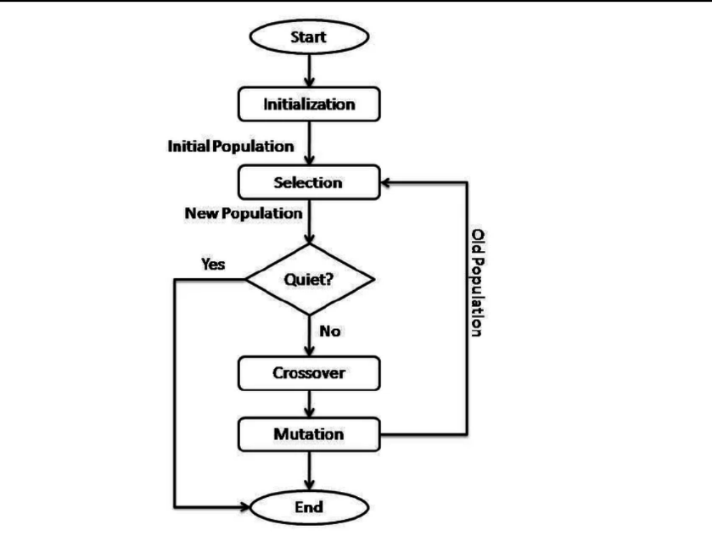
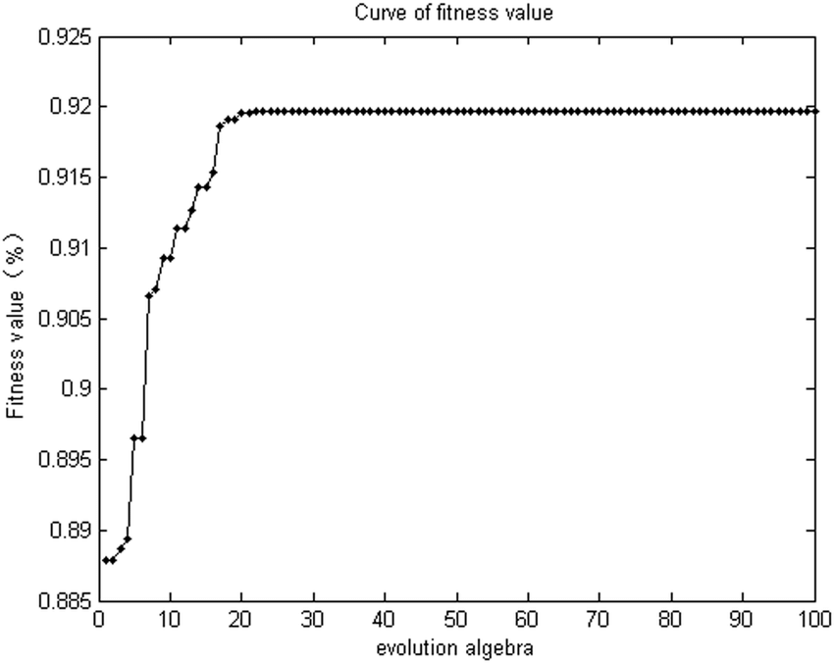
Implementation
Flow chart of working: line graph:

Slide 10
Project Analysis
1. System Overview
The system is designed to automate hyperparameter tuning using a Genetic Algorithm. It takes a dataset as input, preprocesses it, and applies GA to optimize KNN and SVM models. The output is the best model along with optimized parameters and accuracy.
2. Input and Output
Input: Dataset with features and target variable
Output:
Best model (KNN or SVM)
Optimized hyperparameters
Accuracy score
3. Key Components
Data preprocessing module
Genetic Algorithm module
Machine learning models (KNN & SVM)
Evaluation module (accuracy calculation)
Visualization module (graphs and charts)

Slide 11
Project Analysis
4. Working Mechanism
Load and preprocess dataset
Initialize random population
Evaluate fitness using accuracy
Select best individuals
Apply crossover and mutation
Repeat for 50 generations
Select best solution
5. Performance Analysis
Accuracy improves over generations
GA efficiently explores search space
Finds near-optimal hyperparameters
Reduces manual tuning effort
6. Advantages of Proposed System
Automated optimization
Higher accuracy
Efficient search process
Applicable to different datasets

Slide 12
Literature Review: Existing Solutions
1. Genetic Algorithms in Optimization
Genetic Algorithms (GA) are evolutionary techniques inspired by natural selection. They are widely used for solving optimization problems where traditional methods fail. GA works by evolving a population of solutions using selection, crossover, and mutation. It is especially useful in machine learning for searching large hyperparameter spaces efficiently. GA provides near-optimal solutions without exhaustive search.
Reference:https://scholar.google.com/scholar?q=genetic+algorithm+optimization+machine+learning
2. Hyperparameter Tuning in Machine Learning
Hyperparameters significantly affect the performance of machine learning models. Traditional methods like Grid Search and Random Search are commonly used but are computationally expensive. Automated optimization techniques like GA reduce manual effort and improve accuracy. Efficient tuning leads to better generalization of models. Reference: https://scholar.google.com/scholar?q=hyperparameter+tuning+machine+learning
3. K-Nearest Neighbors (KNN) Optimization
KNN is a simple yet effective classification algorithm that depends on the choice of K (number of neighbors). Selecting an inappropriate K value can lead to overfitting or underfitting. Optimization techniques like GA help in selecting the best K value automatically. This improves classification accuracy and model robustness.
Referene: https://scholar.google.com/scholar?q=KNN+optimization+genetic+algorithm
4. Support Vector Machine (SVM) Parameter Optimization
SVM performance depends heavily on hyperparameters like C and gamma. Improper values can reduce classification accuracy. Optimization methods such as GA are used to find the best parameter combination. This enhances the decision boundary and improves model performance.
Reference:https://scholar.google.com/scholar?q=SVM+parameter+optimization+genetic+algorithm
5. GA-based Hybrid Optimization Models
Recent research combines GA with machine learning algorithms for better performance. These hybrid models outperform traditional tuning methods in terms of accuracy and efficiency. GA-based optimization is widely used in classification, prediction, and real-world applications. It reduces computation time while maintaining high accuracy.
Reference:https://scholar.google.com/scholar?q=genetic+algorithm+machine+learning+optimization+hybrid

Slide 13
Result
The Genetic Algorithm was successfully applied to optimize the hyperparameters of KNN and SVM models. Over 50 generations, the algorithm showed a consistent improvement in classification accuracy. The best-performing individual was selected based on the highest accuracy score obtained on the test dataset.
The results indicate that the Genetic Algorithm effectively explored the search space and identified optimal values for hyperparameters such as K (for KNN) and C and gamma (for SVM). The accuracy graph demonstrated a gradual convergence, where both best and average accuracy increased over generations.
Additionally, visualization through pie charts showed the distribution of models selected during the optimization process. In most cases, one model (either KNN or SVM) dominated depending on the dataset characteristics. The final output clearly highlighted the best model along with its optimized parameters and achieved accuracy.

Slide 14
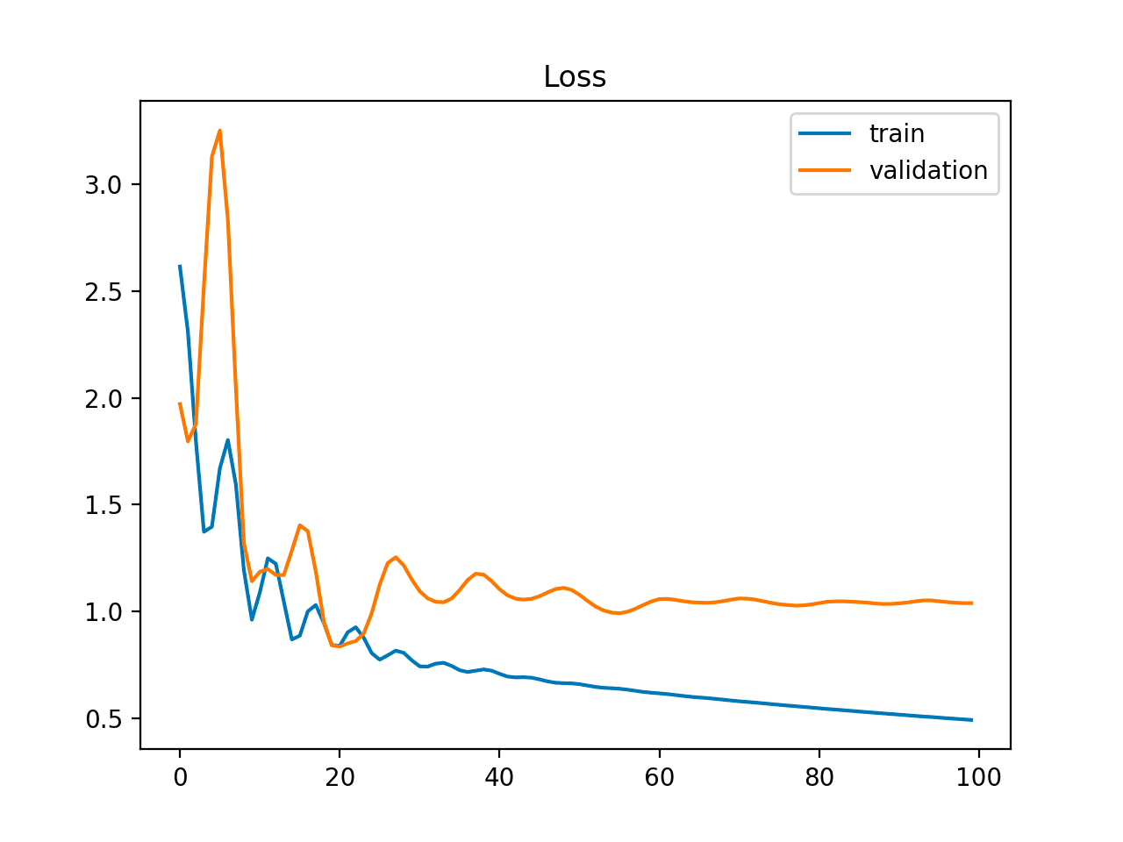
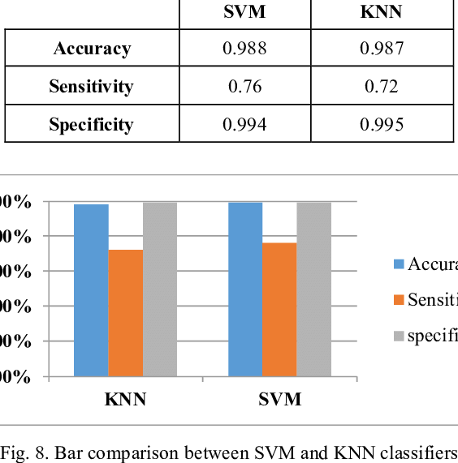
Result

Slide 15
Conclusion
This project demonstrates that Genetic Algorithms are an effective method for hyperparameter optimization in machine learning models. By automating the tuning process, GA reduces manual effort and improves model performance significantly.
The comparison between KNN and SVM shows that the optimal model depends on the dataset, and GA helps in selecting the best one efficiently. The use of evolutionary techniques ensures a balance between exploration and exploitation, leading to better results than traditional methods like grid search.
Overall, the proposed approach enhances accuracy, saves time, and provides a robust solution for model optimization. This method can be extended to more complex models and real-world applications in future work.

Slide 16


